Slide 1
Integers
LI. Learn the meaning of integers numbers
SC. Use of integers numbers in real life
Integers include positive and negative whole numbers and 0
0 neither is positive or negative
1
-0.5
-7
1.3
52
9
4
-21
-2.5
-0.01
18
-1
1
-15
3
2154
0
32

Slide 2
Integers
LI. Learn the meaning of integers numbers
SC. Use of integers numbers in real life
Where do we meet negative numbers in real life.....
Think about it

Slide 3
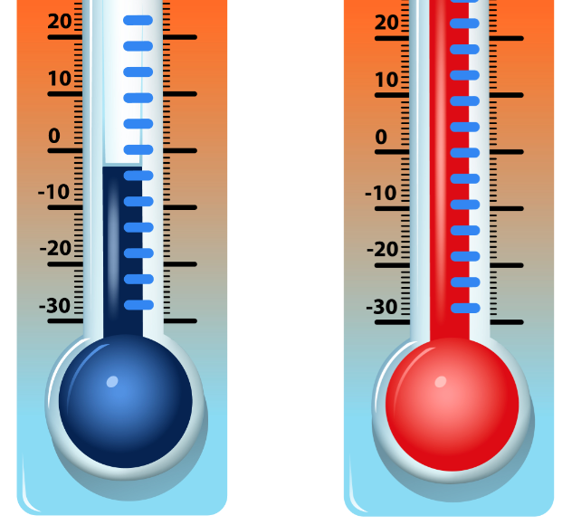
Integers
LI. Learn the meaning of integers numbers
SC. Use of integers numbers in real life
-4ºC
28ºC

Slide 4
Integers
LI. Learn the meaning of integers numbers
SC. Use of integers numbers in real life
Boiling water 100ºC
freezing water-2ºC

Slide 5
Integers
LI. Learn the meaning of integers numbers
SC. Use of integers numbers in real life
Over the sea +3
Surface of sea 0
Below the sea -5

Slide 6
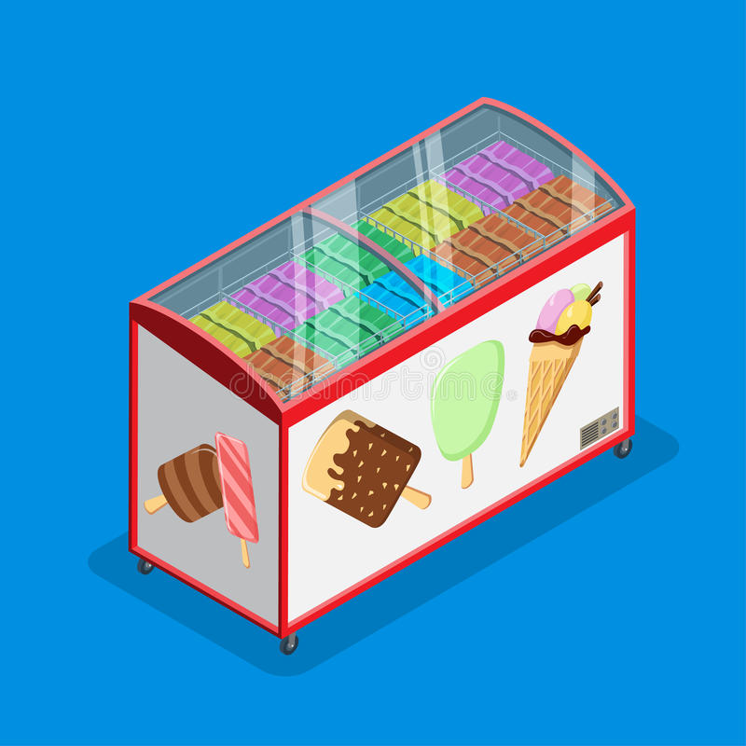
Integers
LI. Learn the meaning of integers numbers
SC. Use of integers numbers in real life
-16º

Slide 7
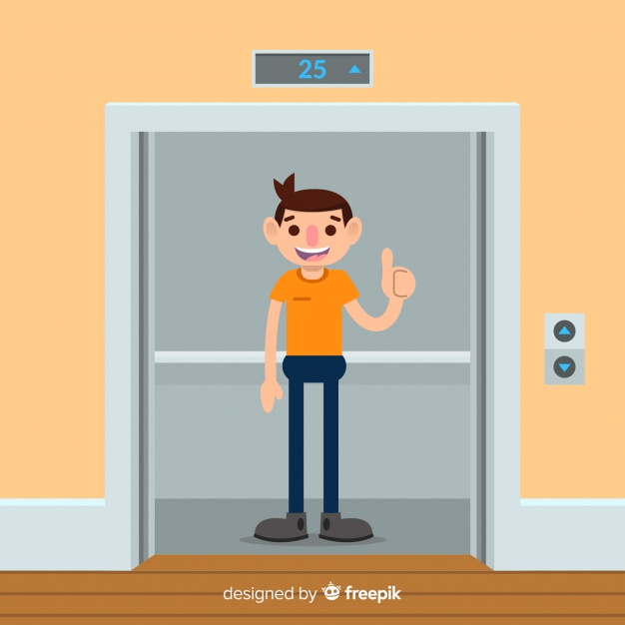
Integers
LI. Learn the meaning of integers numbers
SC. Use of integers numbers in real life
+3 (third floor)
0 (ground floor)
-1 (one level basement)

Slide 8
Integers
LI. Learn the meaning of integers numbers
SC. Use of integers numbers in real life
Withdrawals
When you are taking out money of your account
The amount is going down, so it represents a negative number
Deposits
When you put money into your account
The amount is going up, so it represents a positive number

Slide 9
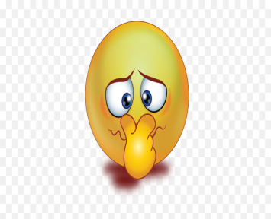
Integers
LI. Learn the meaning of integers numbers
SC. Use of integers numbers in real life
How are you feeling about Maths?
positive
negative

Slide 10
Integers
LI. Learn the meaning of integers numbers
SC. Use of integers numbers in real life
Name the integer represented.
The temperature is 10 degrees below zero
I found £20 on the way to school.
The football team lost 5 yards on the first play.
I earned £78 babysitting.
I made a withdrawal of £786.

Slide 11
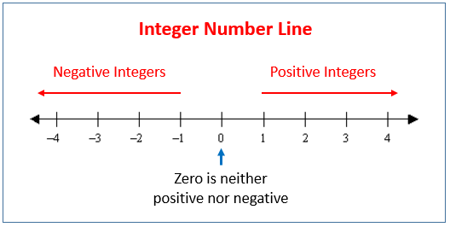
Integers
LI. Learn the meaning of integers numbers
SC. Interpret integers in number line
Integers number line
The more left we go, the numbers get smaller
The more right we go, the numbers get bigger

Slide 12
Integers
LI. Learn the meaning of integers numbers
SC. Understand the value of integers
Which is bigger
As we move to the right the numbers getting bigger
Every positive is bigger than negative
Zero is bigger than every negative
3 and 5
5 > 3
1 and -1
1 > -1
-2 and 0
0 > -2
-2 and -3
-2 > -3
-3 and -4
-3 > -4

Slide 13
Integers
LI. Learn the meaning of integers numbers
SC. Understand the value of integers
Which is smaller
As we move to the left the numbers getting smaller
Every negative is smaller than positive
Negative numbers are smaller than zero
3 and 5
3 < 5
1 and -1
-1 < 1
-2 and 0
-2 < 0
-2 and -3
-3 < -2
-3 and -4
-4 < -3

Slide 14
Put the sign > or <
5 15 11 -5 -4 -3 -2 0 -3 -8 2
-8 -12 23 -3 121 -45 -39 -38 -3 -13 43 49
-2 -12 0 32 -15 0 -3 -4 25 -3 0 5
> (greater than) <(less than)
-5 -15 11 -5 4 3 -2 0 -2 -8 2
-8 -12 23 -4 121 -42 -39 -35 3 -13 43 49
-2 -12 0 32 -11 0 -2 -4 25 -3 0 5

Slide 15
Integers
LI. Learn the meaning of integers numbers
SC. Add and subtract in number line
Add Subtract integers in number line
add =go right
Point in number 2 and move 2 to the right
2 + 2 = 4

Slide 16
Integers
LI. Learn the meaning of integers numbers
SC. Add and subtract in number line
Add Subtract integers in number line
add = go right
Point in number 1 and move 2 places to the right
1 + 2 = 3

Slide 17
Integers
LI. Learn the meaning of integers numbers
SC. Add and subtract in number line
Add Subtract integers in number line
-20
-15
-10
-5
5
10
15
20
Add = go right
Point in number 5 and move 10 to the right
5 + 10 = 15

Slide 18
Integers
LI. Learn the meaning of integers numbers
SC. Add and subtract in number line
Add Subtract integers in number line
Add = go right
Point in number -1 and move 2 places to the right
-1 + 2 = 1

Slide 19
Integers
LI. Learn the meaning of integers numbers
SC. Add and subtract in number line
Add Subtract integers in number line
add = go right
Point in number -4 and move 3 places to the right
-4 + 3 = -1

Slide 20
Integers
LI. Learn the meaning of integers numbers
SC. Add and subtract in number line
Add Subtract integers in number line
Subtract = go left
Point in number 1 and move 2 places to the left
1 - 2 = -1

Slide 21
Integers
LI. Learn the meaning of integers numbers
SC. Add and subtract in number line
Add Subtract integers in number line
Subtract = go left
Point in number 3 and move 5 to the left
3 - 5 = -2

Slide 22
Integers
LI. Learn the meaning of integers numbers
SC. Add and subtract in number line
Add Subtract integers in number line
Subtract = go left
Point in number -2 and move 2 to the left
-2 - 2 = -4

Slide 23
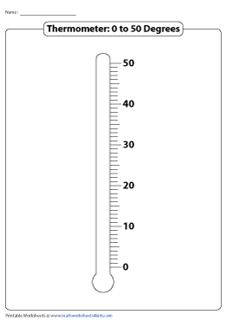
Integers
LI. Learn the meaning of integers numbers
SC. Add and subtract in thermometer line
Add Subtract integers in thermometer
30 +20 =50
Go up when you add
Add = go up
Go to 30 and go up 20
50 – 20 =
30 – 20 =
20 – 30 =
Go down when you subtract

Slide 24
Integers
LI. Learn the meaning of integers numbers
SC. Add and subtract in number line
Target for today
TeeJay 3a
Pg 35
Ex 1, 2
Bonus
worksheet

Slide 25
Integers
LI. Learn the rules of adding integers
SC. Add and subtract integers
Adding positive numbers
Think of two bowls of water
+
=
Cold water
Cold water
Cold water
Add the numbers and put the common sign
+
+
+
+
=

Slide 26
Integers
LI. Learn the rules of adding integers
SC. Add and subtract integers
calculate
+
+
+
=
+
Add the numbers and put the common sign
3+4= | (+5)+(+4)= | 2+(+9)= | 3+3=
+8+8= | 8+(+6)= | (+3)+(+7)= | 7+90=
+8+42= | 9+(+31)= | +90+3= | 5+35=
+9+(+10)= | 7+(+8)= | +8+6= | 4+7=

Slide 27
Integers
LI. Learn the rules of adding integers
SC. Add and subtract integers
Adding negative numbers
Think of two bowls of water
+
=
hot water
hot water
hot water
Add the numbers and put the common sign
-
-
-
+
=

Slide 28
Integers
LI. Learn the rules of adding integers
SC. Add and subtract integers
calculate
-
+
-
=
-
Add the numbers and put the common sign
-3-4= | (-5)+(-4)= | (-2)+(-9)= | -3-3=
-8-8= | -8-6= | (-3)+(-7)= | -7-90=
-8-42= | -9+(-31)= | -90-3= | -5-35=
-9+(-10)= | (-7)+(-8)= | -8-6= | -4-7=

Slide 29
Integers
LI. Learn the rules of adding ingegers
SC. Add and subtract integers
Adding positive and negative
Think of two bowls of water
We are taking cold water because cold water is more than hot
+
=
Cold water
hot water
Cold water
Taking away and put the bigger number sigh
+
-
+
+
=

Slide 30
Integers
LI. Learn the rules of adding ingegers
SC. Add and subtract integers
Adding positive and negative
Think of two bowls of water
We are taking hot water because hot water is more than cold
+
=
hot water
cold water
hot water
Taking away and we put the bigger number sigh
-
+
-
+
=

Slide 31
Integers
LI. Learn the rules of adding integers
SC. Add and subtract integers
Adding positive and negative
Taking away and put the bigger number sign
+
-
+
+
=
+ > -
-
+
-
+
=
- > +

Slide 32
Integers
LI. Learn the rules of adding integers
SC. Add and subtract integers
+
+
-
=
+
+ > -
Remember
Taking away
+
+
-
=
-
- > +
-3+4= | (-5)+(+4)= | (-2)+(+9)= | +3-3=
-8+8= | -8+(-6)= | (+3)+(-7)= | -7+90=
+8-42= | 9+(-31)= | 90-3= | +5-35=
-9+(+10)= | (-7)+(+8)= | 8-6= | -4+7=

Slide 33
Integers
LI. Learn the rules of adding ingegers
SC. Add and subtract integers
Two negatives
-(-) = +
Two negatives turns to positive
-4- (-6) = -4 + 6 =
-19- (-9) =
5- (-7) = 5 + 7 =
5- (-9) =
9- (-9) =
12- (-3) =

Slide 34
Integers
LI. Learn the rules of adding integers
SC. Add and subtract integers
Target for today
TeeJay 3a
Pg 36
Ex 1, 2, 3
Bonus
worksheet

