Slide 1
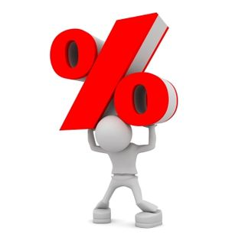
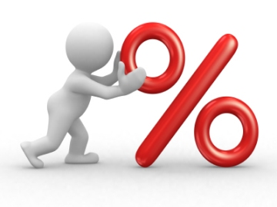
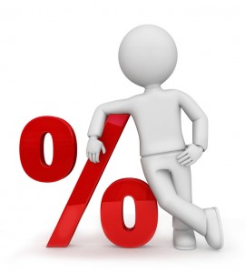
Reverse Percentages

Slide 2
At a shop during a discount event, everything is reduced by 10%. Andrea bought a dress for £36. What is the original price.
100%
90%
£36
10% is $£36 ÷9=£4$
So 100% is $£4 ×10=£40$

Slide 3
Dale runs a cycling club at school, the club budget is reduced by 20%.
Dale now has a budget £100. What was his original budget.
100%
80%
£100
20% is $£100 ÷4=£25$
So 100% is $£25 ×5=£125$ or $£100+£25=£125$

Slide 4
Carol has a 15% off voucher for a firework making course.
Carol’s course now costs her £68. What was the original cost of the course.
100%
85%
£68
Since $85\%=5\% ×17$
5% is $£68 ÷17=£4$
So 100% is $£4 ×20=£80$ or $£68+3 ×£4=£80$

Slide 5
Carl goes to a restaurant that he has a 25% discount card for. He pays £51 for his dinner. a) Work out the original cost.
Carl adds a customary 10% tip onto the price he paid for his dinner. b) Work out Carl’s new total.
100%
75%
£51
25% is $£51 ÷3=£17$
10% of £51 is £5.10
So 100% is $£17 ×4=£68$
Carl’s new total is $£51+£5.10=£56.10$

Slide 6
Maggie takes her family out for a meal and she decides to tip 15%
Maggie’s pays £92. What was the cost the food.
£92
115%
100%
Since $115\%=5\% ×23$
5% is $£92 ÷23=£4$
So 100% is $£4 ×20=£80$ or $£92−3 ×£4=£80$

Slide 7
27% of a number is 81. What is the original number?
Since $27\%=1\% ×27$
1% is $81 ÷27=3$
So 100% is $3 ×100=300$
NB: If the percentage is not a multiple of 5, 10, 25 or 50 then you will need to calculate 1%.

Slide 8
A number is increased by 11% to become 166.5 What is the original number?
Since $111\%=1\% ×111$
1% is $166.5 ÷111=1.5$
So 100% is $1.5 ×100=150$

