Slide 1
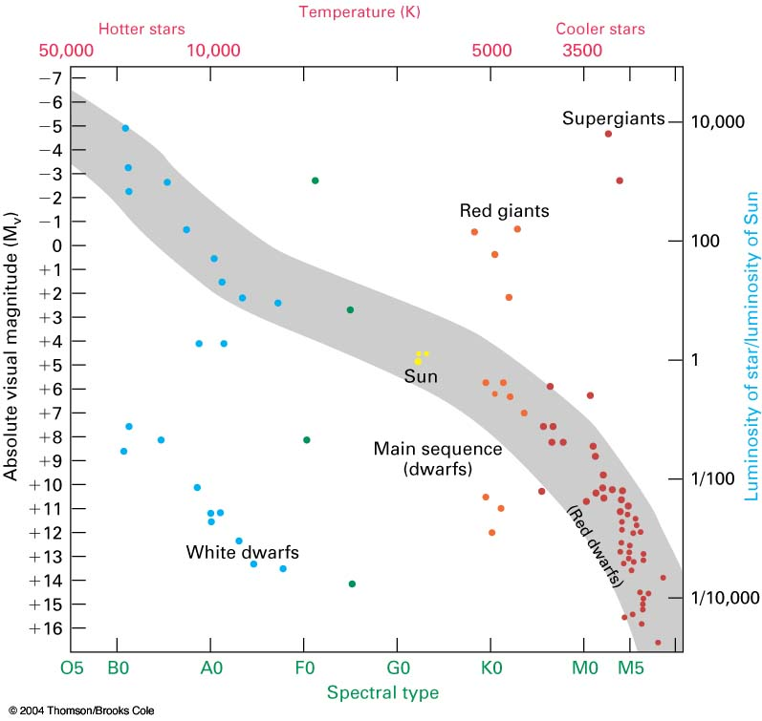
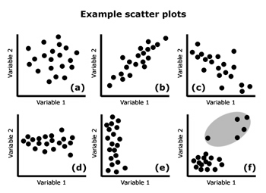
Scatter Graphs

Slide 2
Starter
What patterns can you spot in this data? Is it what you’d expect? Does all the data follow the pattern you’ve spotted?
The data is pupils test marks out of 100 in Maths and Science
Science Mark | Maths Mark
57 | 60
31 | 40
81 | 90
34 | 88
93 | 85
16 | 25
24 | 35
60 | 65
75 | 73
44 | 42

Slide 3
Scatter Graphs
Learning Objectives
All will be able to plot a Scatter Graph for a set of relevant data (Level 5/6)
Most will then be able to state the type of correlation (Level 6)
Some will be able to draw an appropriate line of best fit and use it to make estimates (Level 6)

Slide 4
Scatter Graphs
Today we will be looking at plotting Scatter Graphs
Scatter Graphs are used to represent two linked pieces of data
Once plotted, patterns can more easily be found and estimates can be made from it

Slide 5
Scatter Graphs
Plot a Scatter Graph of the following Information on test marks out of 100.
→ What patterns do you notice?
Science Mark | Maths Mark
57 | 60
31 | 40
81 | 90
34 | 88
93 | 85
16 | 25
24 | 35
60 | 65
75 | 73
44 | 42

Slide 6
Scatter Graphs
You can draw a line of best fit on Data
A line of best fit roughly follows the pattern of the points
It does NOT have to go through any points or start on the axes…
Positive Correlation
→ As one value increases, the other increases
Negative Correlation
→ As one value increases, the other decreases
No Correlation
→ There is no pattern in the data (and therefore no line of best fit…)

Slide 7
Scatter Graphs
Using a line of best fit
100
90
80
70
A pupil scored a mark of 40 on their Science test but was absent for their Maths test. Use a line of best fit to estimate the score they would have achieved
60
50
Maths Mark
40
30
20
10
0
0
10
20
30
40
50
60
70
80
90
100
Science Mark

Slide 8
Plenary

Slide 9
Plenary

Slide 10
Summary
We have learnt to plot Scatter Graphs
We have seen the 3 main types of correlation
We have learnt how to draw and use a line of best fit on a graph

