Slide 1
Objective: to be able to multiply and divide by 10, 100 and 1000 (Level 4)
Skills: Noticing and Making Links
By the end of the lesson:
All: will be able to multiply by 10, 100 and 100
Most: will be able to divide by 10, 100 and 100.
Some: will be able to multiply and divide by and power of 10

Slide 2
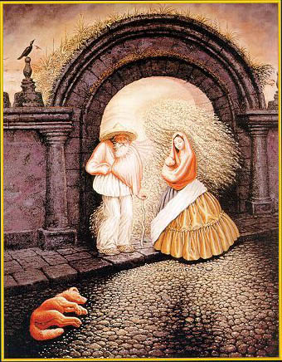
Starter
How many faces?
Try and see how many faces you can see

Slide 3
Finish the sentence
When I multiply by 10, 100 or 1000 I......

Slide 4
Finish the sentence
When I divide by 10, 100 or 1000 I .....

Slide 5
Multiplying by 10, 100, 1000
What do I do when I multiply by 10, 100, 1000?
When I multiply by 10, I shift the digits 1 place to the left. For 100, I shift them 2 places to the left
(show with an example)

Slide 6
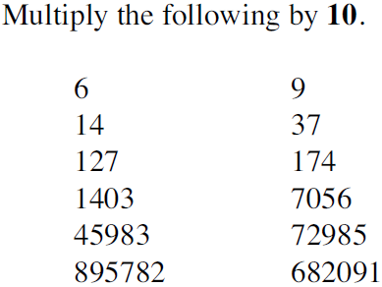
Questions

Slide 7
Answers
60
140
1270
14030
459830
8957820
90
370
1740
70560
729850
6820910

Slide 8
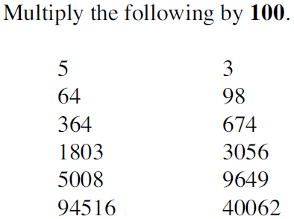
Questions

Slide 9
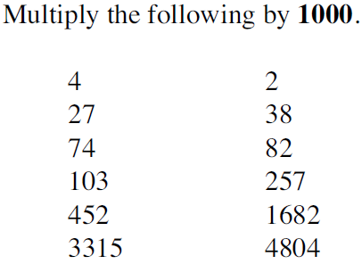
Questions

Slide 10
Dividing by 10, 100, 1000
What do I do when I divide by 10, 100, 1000?
(show with an example)

Slide 11
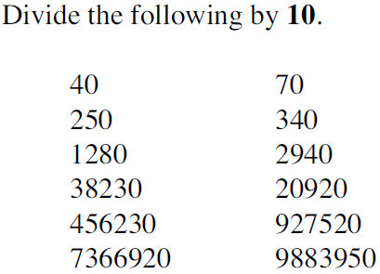
Questions

Slide 12
Answers
4
25
128
3823
45623
736692
7
34
294
2092
92752
988395

Slide 13
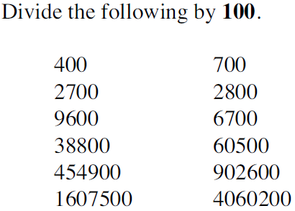
Questions

Slide 14
Answers
4
27
96
388
4549
16075
7
28
67
605
9026
40602

Slide 15
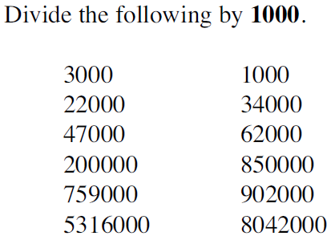
Questions

Slide 16
Answers
3
22
47
200
7590
53160
1
34
62
850
902
8042

Slide 17
Questions

Slide 18
Questions

