Slide 1
1. First machine, 8 boxes: Solutions
102 102 101 98 99 101 103 102
(a) Calculate the mean and standard deviation. (4)
x
x -
x )²
x
(x -
n = 8
Mean = 808 ÷ 8 = 101 pins
102
1
1
102
1
1
20
101
0
0
sd =
(8-1)
98
-3
9
99
-2
4
sd = √2.857…
101
0
0
103
2
4
St. dev. = 1.69 (2dp)
102
1
1
808 0 20

Slide 2
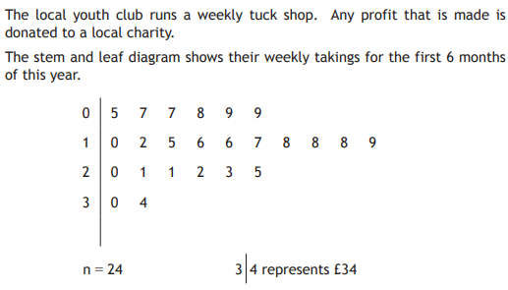
Q3. Calculator allowed, if needed.
Median = £17.50
Q₁ = £9.50
Q₃ = £21
(a)
, and
(b)
Use the data from the stem and leaf diagram to construct a box plot
6
10
14
18
22
26
30
34
Profit £

Slide 3
Q4. Goodhold tyres lap times, in seconds:
81.8 81.7 81.6 81.0 80.3 80.2
(a) Calculate the mean and standard deviation. (4)
x
x -
x )²
x
(x -
n = 6
Mean = 486.6 ÷ 6 = 81.1 seconds
81.8
0.7
0.49
81.7
0.6
0.36
sd =
2.56
81.6
0.5
0.25
5
81.0
-0.1
0.01
80.3
-0.8
0.64
sd = √0.512
80.2
-0.9
0.81
St. dev. = 0.7155..
= 0.72 seconds (2dp)
486.6 0 2.56

Slide 4
Q4.
Fraser changed the tyres to Megagrip tyres and recorded another six laps. These times produced a mean of 81.6 seconds and standard deviation of 0.65 seconds.
(b) Make two valid comments comparing the two types of tyres.
(2)
On average, the lap times on the Goodhold tyres were
faster, shown by the lower mean (81.1< 81.6 seconds).
The lap times on the Megagrip tyres varied less, shown
by the lower standard deviation (0.65 < 0.72 seconds).

Slide 5
Q5. A car costs £15 600 when new.
It depreciates in value by 6.5% each year.
What is it worth when it is sold 3 years later? Give your answer correct to 3 sig. figures.
Depreciation Multiplier = (100 - 6.5)
= 0.935
100
Value in 3 years = 15 600 x 0.935³
= 12 751.44585
Value = £12 751.45
To 3 sig figs = £12 800

Slide 6
Q6. It is estimated that house prices will increase at the rate of 3.15% per annum. A house is valued at £134 750. If its value increases at the predicted rate, calculate its value after 3 years.
Give your answer to 3 significant figures.
Increase Appreciation = (100 + 3.15)
= 1.0315
100
Value in 3 years = 134 750 x 1.0315³
Value = £147 889.20
3 sig figs = £148 000

Slide 7
Money: Foreign currency but Calculator allowed.
Q7
money, on a cruise.
(2 marks)
2017, P2, Q5c.
1320 x 1.15 = 1518

Slide 8
Q8.
Fiona paid £78000 for her house ten years ago.
She sold it recently for £109000.
Calculate the percentage profit Fiona made.
Give your answer to 2 significant figures.
Profit made = 109000 – 78000
= 31000
Profit fraction = 31000 = 31
78000 78
% profit = 31 of 100%
78
% profit = 100 ÷ 78 x 31
% profit = 39.7425…
% profit = 40% (2 sf)

Slide 9
Q9.
(a) How much is John’s gross weekly pay?
Gross weekly pay = 8.50 x 40 Non calc.?
Gross weekly pay = £340
Gross monthly pay = 8.50 x 160 = £1360
Total Deductions = 190 + 118 + 82 = £390
Monthly take home pay = £1360 - £390
= £970

Slide 10
Q10.
(a) Gross monthly pay = 9.70 x 180
= £1746
(b) (10%) Pension = 1746 ÷ 10 = £174.60
Total Deductions = 380 + 208.40 + 174.60 = £763
Take home pay = £1746 - £763
= £983

Slide 11
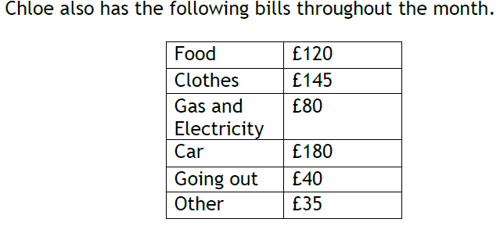
Q10.
(b) Take home pay
= £983
c) After all these Expenses, what percentage of her take home pay
does Chloe have left?
Total Expenses = £600
Money left = £983 - £600 = £383
Fraction of pay = 383
983
% Left = 383 of 100%
983
% left = 100 ÷ 983 x 383 = 38.9623…
% take home pay left = 39% (to nearest %)

Slide 12
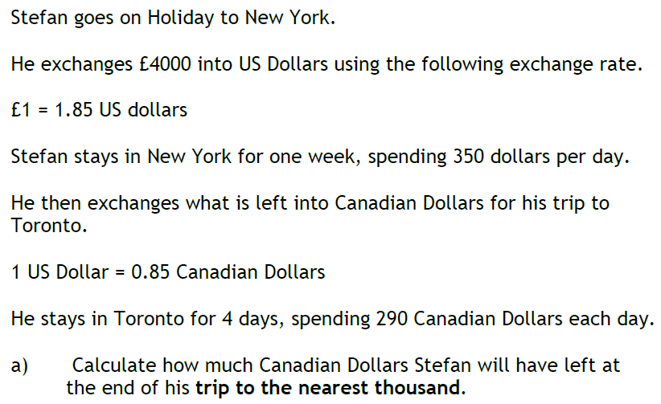
Q11.
£ to $_{US} = 4000 x 1.85 = $7400
Spends = 350 x 7 = $_{US}2450
$_{US} left = 7400 - 2450 = $_{US}4950
$_{US} to $_{Can} = 4950 x 0.85 = $_{Can}4207.50
Spends = 290 x 4 = $_{Can}1160
$_{Can} left = 4207.50 - 1160 = $_{Can}3047.50
To nearest $_{Can}1000 = $_{Can}3000

Slide 13
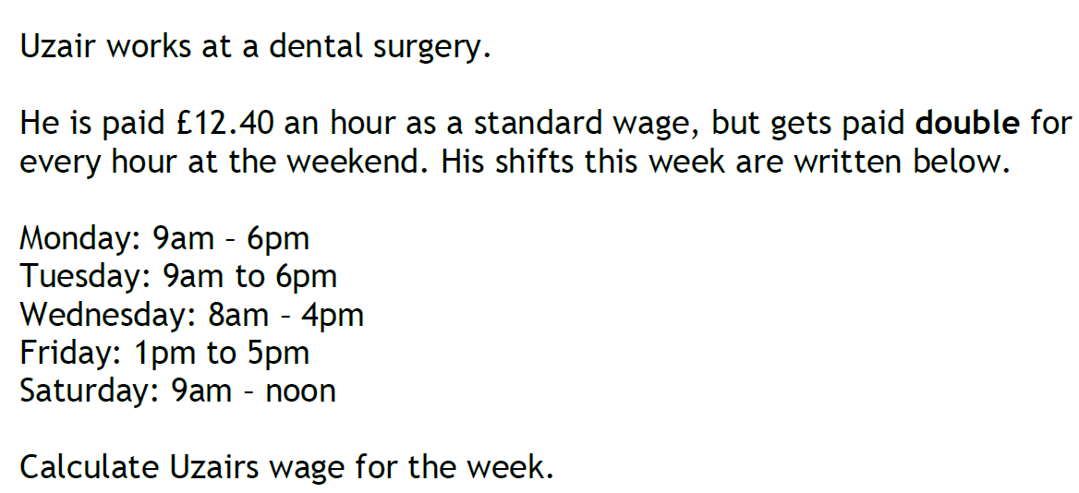
Q12.
time-and-a-half
for each hour at the weekend. His shifts this week are shown below.
Mon = 9 basic hours
Tues = 9 basic hours
Wed = 8 basic hours
Fri = 4 basic hours
Sat = 3 OT hours
= 3 x 1.5
= 4.5 basic hours
Total hours = 9 + 9 + 8 + 4 + 4.5 = 34.5 hours
Wages for week = 34.5 x 12.40
= £427.80

Slide 14
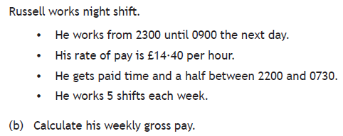
Q13.
0730-0900 = 1.5 basic hours = 14.40 x 1.5 = £21.60 each shift
2300-0730 = 8.5 OT hrs = 14.40 x 1.5 x 8.5 = £183.60 each shift
Wages for 1 shift = 21.60 + 183.60 = £205.20
Gross weekly pay = £205.20 x 5
= £1026

Slide 15
Q14(a).
Population increase = 1 816 000 - 1 780 000
= 36 000
Increase fraction = 36 000 = 36
1 780 000 1780
% increase = 36 of 100%
1780
% increase = 100 ÷ 1780 x 36 = 2.0224…
% increase = 2.02 (2dp)

Slide 16
Q14(b).
2019 value = 1 816 000
Increase Appreciation = (100 + 1.25)
= 1.0125
100
Population in 5 years = 1 816 000 x 1.0125⁵
Population = 1 932 373.191
To nearest 1000 = 1 932 000

