Slide 1
Activity Networks and Precedence Tables.
Organising the tasks within a project.

Slide 2
NOTES
Activity Networks.
An activity network shows all the tasks needed to complete a larger project. It puts tasks in order and shows any that can be done at the same time (written above each other).
Read the network from left to right.
The CRITICAL path is the time needed to complete the whole project.
Calculate the critical path by adding all the longest times in each group of tasks. This will be the minimum time needed to ensure the whole project is finished.

Slide 3
NOTES
Eg: Find the minimum time to complete this network
(times are in minutes).
Cook Chicken
10
Preparationtime
10
Start
Cook Spaghetti
15
Serve
3
Stop
A
B
C
D
Cook sauce
30
The critical path = 10 + 30 + 3
= 43 minutes

Slide 4
Try this…
Three friends tidy the flat they share as follows:
Times are in minutes.
Tidy Bathroom
13
Prepare to tidy
5
Start
Tidy Lounge
14
Clear up
2
Stop
A
B
C
D
Tidy Bedroom
16
Guests are due in 20 minutes. Will the flat be tidy?
The critical path = 5 + 16 + 2 = 23 minutes
No, because the minimum time needed to tidy the flat is 23 minutes (23 > 20).

Slide 5
Example of Nat 5 App problem: Cooking Pasta.
Table of tasks and how long each takes (NOT in order).
Task | Summary | Preceding Task | Time (secs)
A | Boil the kettle | None | 120
B | Turn on hob and cook for several minutes | C | 300
C | Add boiling water to the pot | A, F | 30
D | Place pasta in a pot | None | 10
E | Drain water | B | 40
F | Add salt to the pot | D | 10
A
120
(a) Complete this diagram with the tasks
and times.
C
30
B
300
E
40
D
10
F
10
(b) How long does it take to cook the
pasta ?
120 + 30 + 300 + 40 = 490 seconds

Slide 6
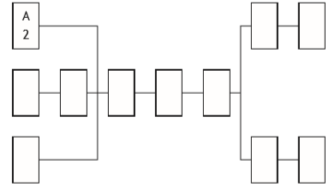
Work sheet Problems.
Networks have been printed.
Q1. Building with the Fence Direct team of workers.
A
2

Slide 7
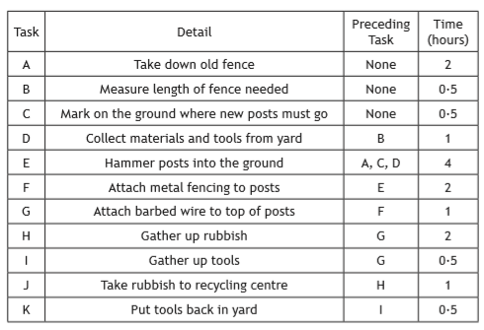
Q1. Tasks needed to build a new Fence Direct fence.
Complete the diagram with the tasks and times.
(b) Fence Direct claim that they can complete a fence in
10 hours. Is this valid claim ? Give a reason.

Slide 8
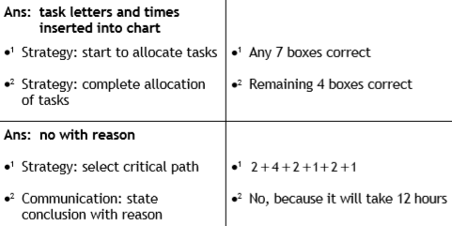
H
2
J
1
B
0.5
D
1
E
4
F
2
G
1
C
0.5
I
0.5
K
0.5
(b) 10 hours claim?

Slide 9
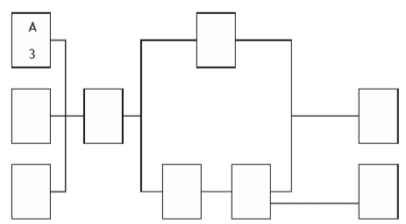
2014 P1, Q6
Q2. Building a Kitease kitchen with a team of workers.
A
3

Slide 10
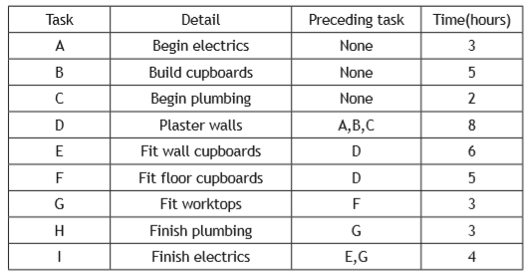
Q2. Tasks needed to fit a new Kitease kitchen.
Complete the diagram with the tasks and times.
(b) Kitease claim that they can install a kitchen in
22 hours. Is this valid claim ? Give a reason.

Slide 11
A
3
E
6
(b) 22 hours claim?
B
5
D
8
I
4
C
2
F
5
G
3
H
3
(b)
2014 P1, Q6

Slide 12
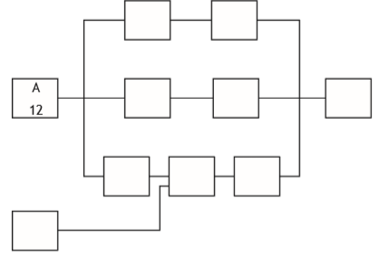
Q3. Develop a new games console and bring it to market.
A
12
2016 P1, Q5

Slide 13
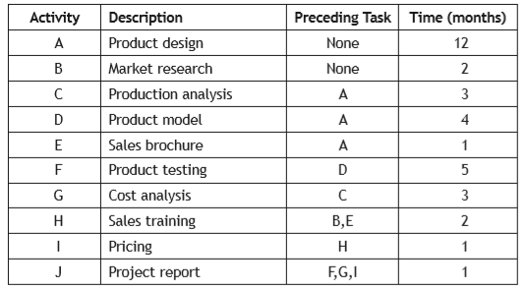
Q3.Tasks needed to develop a new games console & bring it to market.
Complete the diagram with the tasks and times.
(b) The company want to complete the whole process in
2 years. Is this possible? Justify your answer.

Slide 14
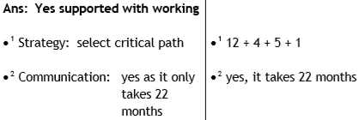
C
3
G
3
2016 P1, Q5
A
12
D
4
F
5
J
1
(b) Can the process
be done in less
than 2 years ?
E
1
H
2
I
1
B
2

Slide 15
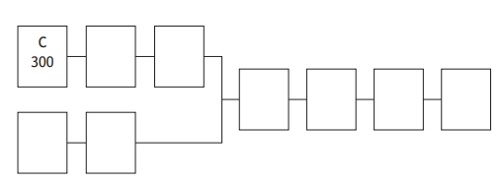
2018 P2, Q9(a+b)
Q4. Production of tins of beans.

Slide 16
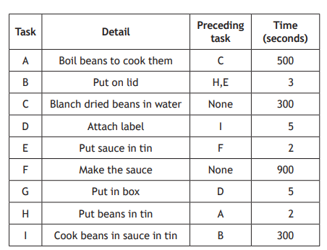
Q4.Tasks and times needed to produce cans of tinned beans.
Complete the diagram with the tasks and times. (1)
(b) The factory manager thinks the whole process can be
completed in less than 25 minutes. Is he correct? (2)

Slide 17
2018 P2, Q9(a+b)
A
500
H
2
B
3
I
300
D
5
G
5
F
900
E
2
(a) Must have times, as well as letters.

Slide 18
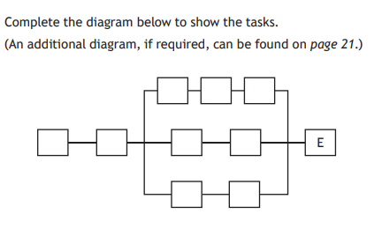
2019 P2, Q9(b)
Q5. Tasks involved in publishing a book.

Slide 19
(b) Complete the diagram to show the tasks. (2)

Slide 20
D
F
G
C
B
I
J
H
A
2019 P2, Q9(b)

Slide 21
Another way to organise the tasks that make up a bigger project:
Writing activities in a table instead of a diagram.
Order of Activities | Activities that could be done at the same time
C
G
A | E
H | B
F
D
You
can write phrases instead of letters

Slide 22
Try this… The following is a list of things you need to do
if you were going to see a 3-D film at the cinema:
A Meet with some friends
B Collect tickets
C Travel to cinema
D Watch movie
E Book tickets
F Get ready
G Buy popcorn
H Pick up 3D glasses
Some of these activities might be done at the same time.
Construct a precedence table, putting the activities into a logical order and identify one occasion when two activities could be done at the same time.
Put the second activity in the right-hand column.
Order of Activities.
Activities that could be done at the same time.
Table has 8 empty rows

Slide 23
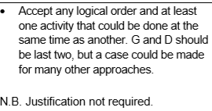
Order of Activities | Activities that could be done at the same time
E
F
C
A
B | H
G
D
Use letters or phrases

Slide 24
Work on other Logic network type problems:
TJ Nat 5 Life skills, Page 170-171,
Ex 3, Qs 1, 5 & 6.

Slide 26
Challenge. Try constructing a logic network on your own!
Find the critical path and calculate the minimum time to prepare breakfast from this list of tasks and conditions.
Times are in minutes.
A | Grind coffee beans | 1
B | Slice bread | 2
C | Heat pan | 3
D | Set table | 5
E | Make toast | 3
F | Make coffee | 2
G | Cook bacon | 5
H | Cook tomato | 2
I | Cook eggs | 3
Conditions.
You have to complete:
A before F
B and C before E
C before G
E, F and I before H
B, C, E and G before I.

Slide 27
A possible answer.
The critical path:
C – G – I – H
= 3 + 5 + 3 + 2
= 13 minutes minimum
A
1
B
2
E
3
F
2
I
3
H
2
C
3
G
5
You have to complete:
A before F
B and C before E
C before G
E, F and I before H
B, C, E and G before I.
D
5

Slide 28
Nat 5 App Unit Question type problems.

Slide 29
The following is a list of things you need to do if you had invited friends for dinner:
A Cook food
B Withdraw enough money
for food from a cash machine
C Prepare food
D Go to supermarket
E Buy ingredients
F Arrange table
G Eat the food
H Wash dishes
Some of these activities might be done at the same time.
Complete a precedence table, putting the activities into a logical order and identify one occasion when two activities could be done at the same time.
Put the second activity in the right-hand column.
Order of Activities.
Activities that could be done at the same time.
Table has 8 empty rows

Slide 30
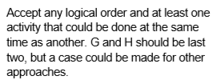
Order of Activities | Activities that could be done at the same time
B
D
E
C
A | F
G
H
Use letters or phrases

Slide 32
Precedence Tables Worksheet.
Q1. Building with the Fence Direct team of workers.
A
2

Slide 33
2014 P1, Q6
Q2. Building a Kitease kitchen with a team of workers.
A
3

Slide 34
2016 P1, Q5
Q3. Develop a new games console and bring it to market.
A
12

Slide 35
2018 P2, Q9(a+b)
Q4. Production of tins of beans.
C
300

Slide 36
2019 P2, Q9(b)
Q5. Tasks involved in publishing a book.
E

